Slide 1
Stellar Evolution
Emulator
Karthik Boyareddygari and Reese Danzer

Slide 2
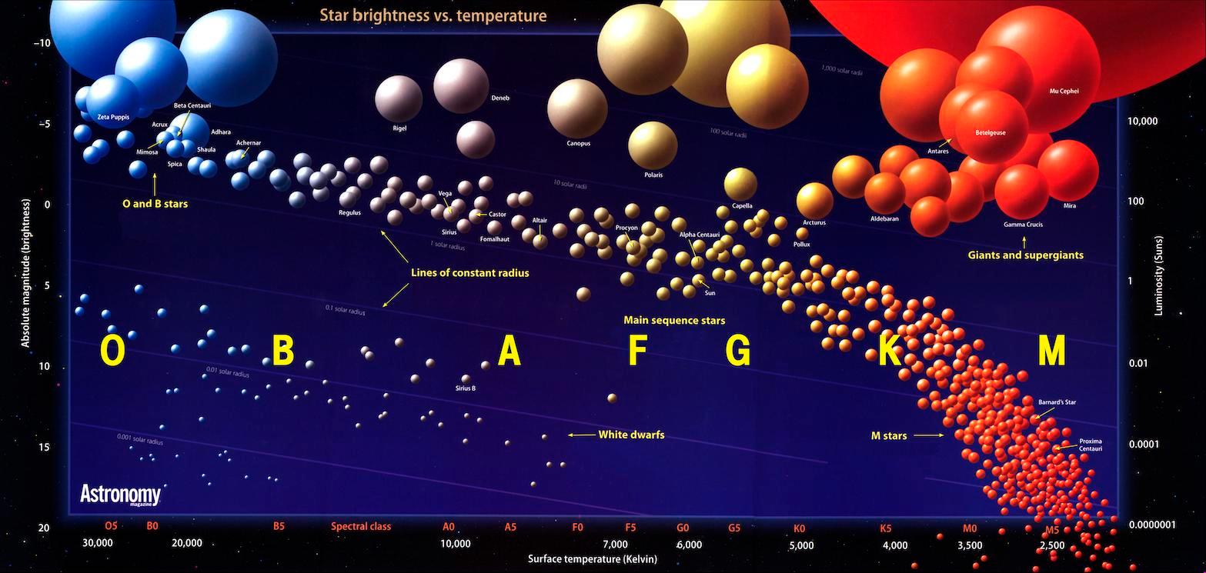
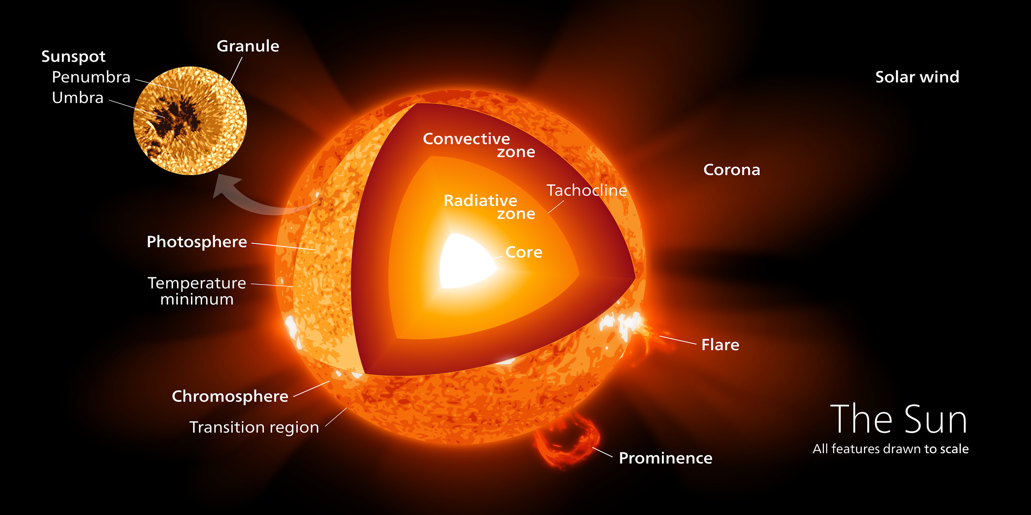
Project Summary
Our project is intended to simulate the evolution of a star across its lifetime, from Zero Age Main Sequence (ZAMS) onward. The user will have control over the starting mass of the star and the ability to manipulate the displays of the star temporally using a slider. This star will relatively accurately model a real-life star.
Sources: https://en.wikipedia.org/wiki/Sun, http://cococubed.asu.edu/pix_pages/hr_diagram.shtml

Slide 3
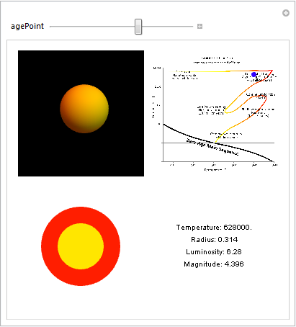
The Interface
Our interface is composed of four graphics:
A sphere that will show how the star would appear if seen from a fixed point outside it.
A set of concentric disks that will represent the internal structure of the star.
A set of readouts that will print information about the star and its internal structure.
An HR diagram with a point representing the star, showing the luminosity and magnitude of the star.
All of these graphics will be constantly updated with a time slider controlled by the user.

Slide 4
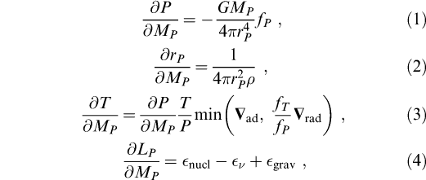
Data
We currently have two possible options for how we will produce realistic stellar data to be displayed by the interface
Differential Equations: We input the system of DE’s that are used to model star evolution and have Mathematica solve them numerically (analytically if possible) to find functions for all our parameters that are dependent upon time.
Database Search: If the differential equations turn out to be inefficient, then we will build a database and have the interface consult that database instead. The database would consist of a list of attributes for the star at critical points in time. Our program will need to interpolate values between data points to create a continuous temporal spectrum.

Slide 5
Progress
We have thus far created the interface, we need data. Currently, our program uses placeholder values until real data can be input in. We have been doing research into the different methods for data generation, and are now beginning to code the functions for creating and interpreting real data.

